Slide 1
Macroeconomics ECON 101
Monetary Policy
(Chapter 11)
Instructor: Muhebullah Karimzada
Notes:
If this PowerPoint presentation contains mathematical equations, you may need to check that your computer has the following installed:
1) MathType Plugin
2) Math Player (free versions available)
3) NVDA Reader (free versions available)

Slide 2
Chapter Outline
11.1 What is Monetary Policy?
11.2 The Money Market and the Bank of Canada’s Choice of Monetary Policy Targets
11.3 Monetary Policy and Economic Activity
11.5 A Closer Look at the Bank of Canada’s Setting of Monetary Policy Targets

Slide 3
What is Monetary Policy?
11.1 Learning Objective
Define monetary policy and describe the Bank of Canada’s monetary policy goals.
In the last chapter, we introduced the monetary policy tools that the Bank of Canada can use to influence the money supply. In this chapter,
We’ll address how and why the Bank of Canada takes the actions that it does.
We’ll pay special attention to the unique circumstances surrounding the recessions of 2007–2009 and 2020 and the Bank of Canada’s responses to those circumstances.

Slide 4
What is the Role of the Bank of Canada?
Since its creation in 1934, the main responsibility of the Bank of Canada is to conduct monetary policy “in the best interests of the economic life of the nation.”
Since World War II, the Bank of Canada has carried out an active monetary policy.
Monetary policy refers to the actions the Bank of Canada takes to manage the money supply and interest rates to pursue macroeconomic policy goals.

Slide 5
The Goals of Monetary Policy
The Bank of Canada pursues four main monetary policy goals:
Price stability
High employment
Stability of financial markets and institutions
Economic growth
We will briefly consider each of these goals.

Slide 6
The Money Market and the Bank of Canada’s Choice of Monetary Policy Targets
11.2 Learning Objective
Describe the Bank of Canada’s monetary policy targets and explain how expansionary and contractionary monetary policies affect the interest rate.
The Bank of Canada has two monetary policy tools at its disposal:
Open market operations
Lending to financial institutions
It uses these tools to try to influence the inflation rate (and the unemployment rate). However, the Bank of Canada cannot directly influence prices.
Instead it influences its monetary policy targets:
The money supply
The interest rate (primary monetary policy target of the Bank of Canada)

Slide 7
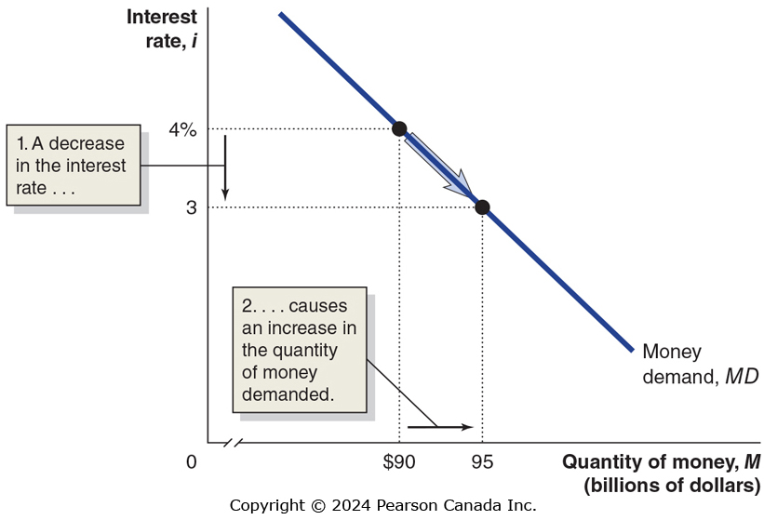
Figure 11.2 The Demand for Money
The BoC’s two monetary policy targets are related in an important way:
Higher interest rates result in a lower quantity of money demanded.
Why? When the interest rate is high, alternatives to holding money begin to look attractive—such as Canada bonds.
So the opportunity cost of holding money is higher when the interest rate is high.
Notes:
Note: We use BoC for Bank of Canada.

Slide 8
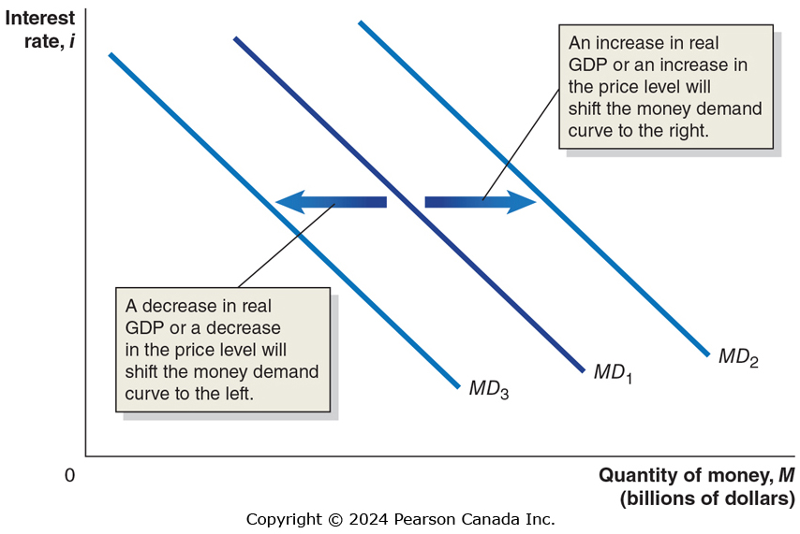
Figure 11.3 Shifts in the Money Demand Curve
What could cause the money demand curve to shift?
A change in the need to hold money to pay for goods and services (consumption).
If more transactions are taking place (higher real G D P) or more money is needed for each transaction (higher price level), the demand for money will be higher.
Decreases in real G D P or the price level decrease money demand.

Slide 9
How the BoC Manages the Money Supply?
We saw in the previous chapter that the Bank of Canada alters the money supply by buying and selling government securities.
To increase the money supply, the Bank of Canada buys those securities, the sellers deposit the sale proceeds in a checking account, and the money gets loaned out—increasing the money supply.
To decrease the money supply, the Bank of Canada sells securities, which decreases bank reserves and contracts the money supply.

Slide 10
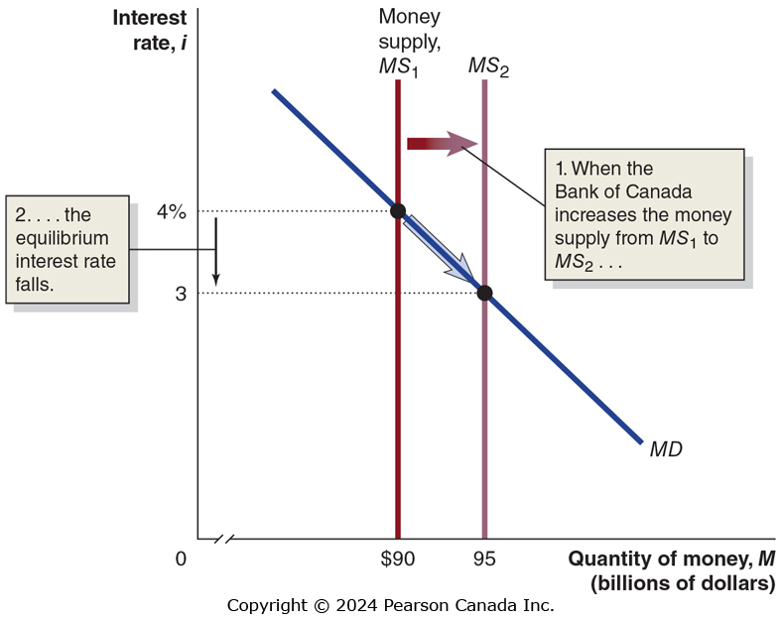
Figure 11.4 The Effect on the Interest Rate When the Bank of Canada Increases the Money Supply
For simplicity, we assume the BoC can completely control the money supply.
Then the money supply curve is a vertical line—it does not depend on the interest rate.
Equilibrium occurs in the money market where the two curves cross.
When the BoC increases the money supply, the short-term interest rate must fall until it reaches a level at which households and firms are willing to hold the additional money.

Slide 11
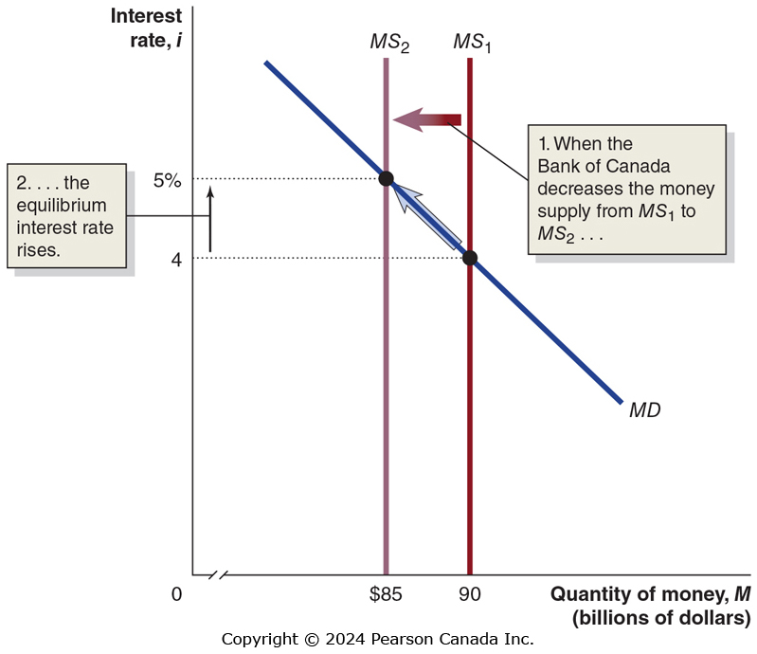
Figure 11.5 The Effect on the Interest Rate When the Bank of Canada Decreases the Money Supply
Alternatively, the Bank of Canada may decide to lower the money supply, by selling Canada bonds.
Now firms and households (who bought the securities with money) hold less money than they want, relative to other financial assets.
In order to retain depositors, banks are forced to offer a higher interest rate on interest-bearing accounts.

Slide 12
A Tale of Two Interest Rates
We now have two models of the interest rate:
The loanable funds model (chapter 6)
Concerned with long-term real rate of interest
Relevant for long-term investors (firms making capital investments, households building new homes, etc.)
The money market model (this chapter)
Concerned with short-term nominal rate of interest
Most relevant for the Bank of Canada: changes in money supply directly affect this interest rate.
Usually, the two interest rates are closely related; an increase in one results in the other increasing also.

Slide 13
Choosing a Monetary Policy Target
The Bank of Canada can choose to target a particular level of the money supply, or a particular short-term nominal interest rate.
It focuses on the interest rate more than on the money supply.
There are many different interest rates in the economy; the Bank of Canada targets the overnight rate: the interest rate banks charge each other for overnight loans.
The Bank of Canada announces the target for the overnight interest rate on eight “fixed” dates throughout the year. Bank uses open market operations to set a target for overnight interest rate and usually comes very close to reaching it.

Slide 14
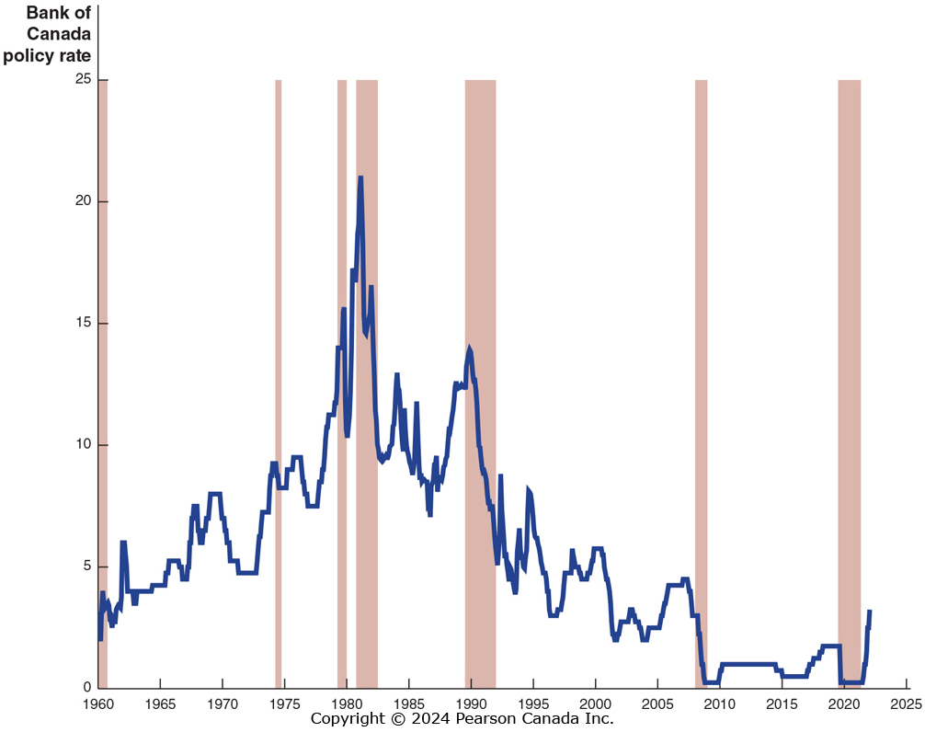
Figure 11.6 Overnight Interest Rate Targeting, July 1960–September 2022
Over the years, the Bank of Canada has pushed the overnight rate up and down to achieve its policy goals.
In response to the financial crisis in 2007– 2009 and the COVID-19 pandemic in 2020, BoC cut the target overnight rate several times.
A change in overnight rate has a greater effect on short-term than long-term rates.
SOURCE: Bank for International Settlements, www.bis.org.

Slide 15
Monetary Policy and Economic Activity
11.3 Learning Objective
Use aggregate demand and aggregate supply graphs to show the effects of monetary policy on real G D P and the price level.
The ability of the Bank of Canada to affect economic variables such as real GDP depends on its ability to affect long-term real interest rates.
It uses the overnight interest rate (a short-term nominal interest rate) for this—an imperfect tool.
We will assume in this section that the Bank of Canada can affect long-term real interest rates using the overnight interest rate.

Slide 16
How Interest Rates Affect Aggregate Demand
Interest rates affect aggregate demand through:
Consumption
Lower interest rates encourage buying on credit, which typically affects the sale of durables. Lower rates also discourage saving.
Investment
Lower interest rates encourage capital investment by firms:
By making it cheaper to borrow (sell corporate bonds).
By making stocks more attractive for households to purchase, allowing firms to raise funds by selling additional stock.
Lower rates also encourage new residential investment.
Net exports
High Canadian interest rates attract foreign funds, raising the Canadian dollar exchange rate, causing net exports to fall, and vice versa.

Slide 17
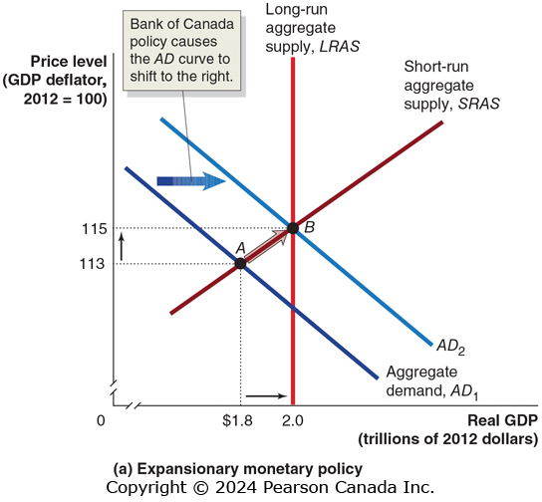
Figure 11.7 Monetary Policy (1 of 2)
The BoC conducts expansionary monetary policy when it takes actions to decrease interest rates to increase real GDP.
This works because decreases in interest rates raise consumption, investment, and net exports.
The BoC would take this action when short-run equilibrium real GDP was below potential real GDP.
The increase in aggregate demand encourages employment.

Slide 18
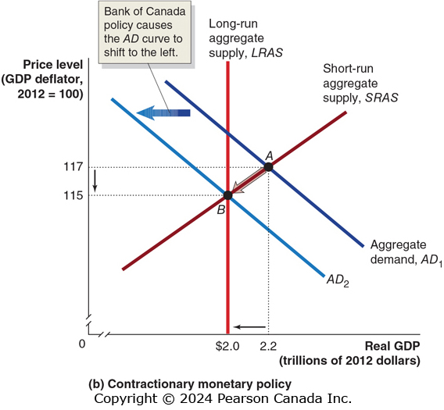
Figure 11.7 Monetary Policy (2 of 2)
Sometimes the economy may be producing above potential G D P.
In that case, the BoC may perform contractionary monetary policy: increasing interest rates to reduce inflation.
Why would the BoC intentionally reduce real G D P?
The BoC is mostly concerned with long-run growth. If it determines that inflation is a problem for long-run growth, it can contract the money supply to discourage inflation, i.e. encourage price stability.

Slide 19
Can the Bank of Canada Eliminate Recessions?
In our demonstration of monetary policy, the Bank of Canada
Knew how far to shift aggregate demand, and
Was able to shift aggregate demand exactly this far.
In practice, monetary policy is much harder to get right than the Figure 11.7a makes it appear.
Completely offsetting a recession is not realistic; the best the Bank of Canada can hope for is to make recessions milder and shorter.
Another complicating factor is that current economic variables are rarely known; we usually can only know them for the past—i.e. with a lag.
For example, Statistics Canada will only publish G D P numbers for the 4th quarter of 2024 (October through December) in March, 2025.

Slide 20
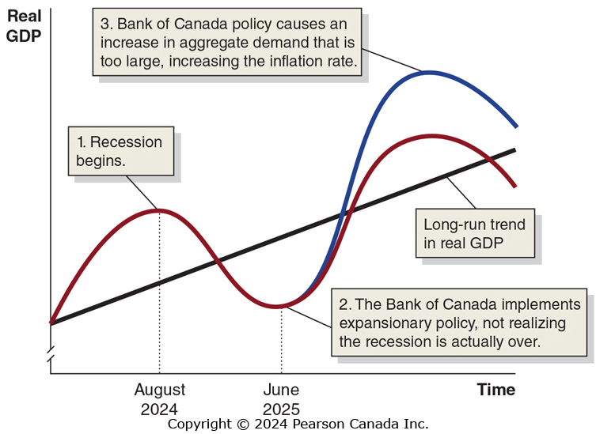
Figure 11.8 The Effect of a Poorly Timed Monetary Policy on the Economy
Suppose a recession begins in August 2024.
The BoC finds out about the recession with a lag.
In June 2025, the BoC starts expansionary monetary policy, but the recession has already ended.
By keeping interest rates low for too long, the BoC encourages real G D P to go far beyond potential G D P. The result is:
High inflation, and
The next recession will be more severe

Slide 21
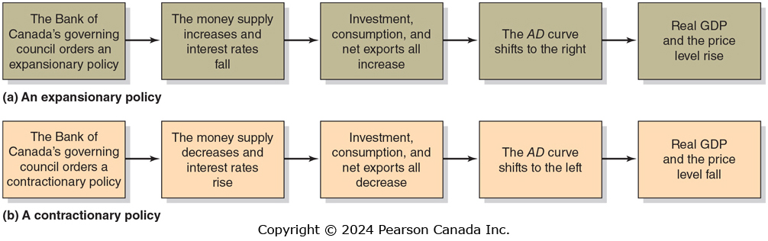
Figure 11.9 Expansionary and Contractionary Monetary Policies

Slide 22
A Closer Look at the Bank of Canada’s Setting of Monetary Policy Targets
11.5 Learning Objective
Discuss the Bank of Canada’s setting of monetary policy targets.

Slide 23
Should the BoC Target the Money Supply?
In normal times, the BoC targets the overnight rate.
Should it use the money supply as its monetary policy target instead?
Monetarists, led by Nobel Laureate Milton Friedman, said “yes”.
Friedman advocated a monetary growth rule, increasing the money supply at about the long-run rate of real G D P growth.
He argued that an active countercyclical monetary policy would serve to destabilize the economy; the monetary growth rule would provide stability instead.
Monetarism was popular in the 1970s. but since the 1980s, the link between the money supply and real G D P seems to have broken down. M1+ seems to change “wildly”, but real G D P and inflation do not react in the same way.
As a result, support for following a monetary growth rule has declined.

Slide 24
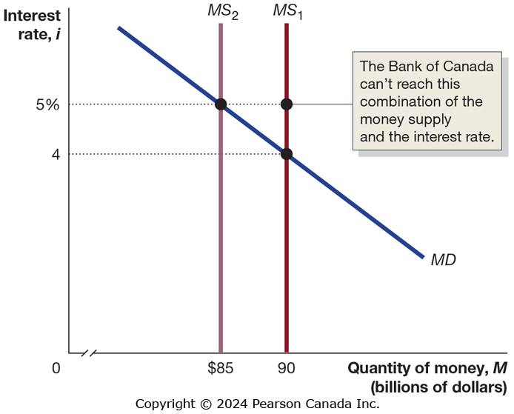
Figure 11.12 The Bank of Canada Can’t Target Both the Money Supply and the Interest Rate
It might seem that the BoC could “get the best of both worlds” by targeting both interest rates and the money supply.
But this is impossible: the two are linked through the money demand curve.
So a decrease in the money supply will increase interest rates; an increase in the money supply will decrease interest rates.

Slide 25
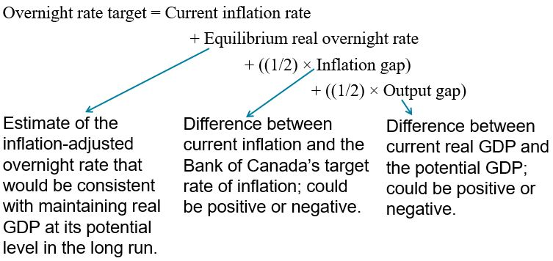
The Taylor Rule (1 of 2)
The Taylor rule is a rule developed by John Taylor of Stanford University, that links a central bank’s target for the overnight rate to economic variables. Taylor estimates that:

Slide 26
The Taylor Rule (2 of 2)
The weights of (1/2) would be different if the Bank of Canada was more or less concerned about the inflation gap or the output gap.
In the Taylor rule, the inflation gap coefficient is greater than zero which means that increasing inflation rate by 1%, overnight interest rate should increase more than 1% to ensure an increase in the real interest rate. This is known as Taylor principle.
Taylor principle is critical to the success of monetary policy as it ensures that monetary policy is stabilizing.
Although the Taylor rule does not account for changes in inflation rate or interest rate, many economists view it as a convenient tool for analyzing the overnight funds target.

Slide 27
Inflation Targeting
Inflation targeting: is known as a framework for conducting monetary policy that involves the central bank announcing its target level of inflation.
In 1980s, inflation targeting was adopted by many central banks.
In 2012 Fed also announced to attempt to maintain an average inflation rate of 2 percent per year.
Inflation target informs the public about BoC’s capability.
It also provides an anchor for inflationary expectations.
It provides accountability for the central bank for achieving the target.
Economists and policymakers continue to debate whether inflation targets improve economic policy.
In 2021, central banks around the world had adopted inflation targeting—but no central bank had yet adopted nominal GDP targeting.

